Slide 1
Student Registration System
Simple Java
Project

Slide 2
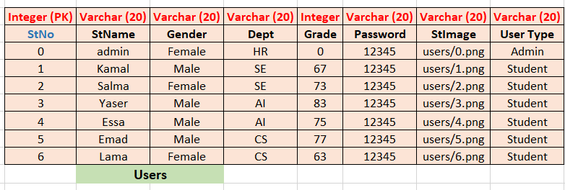
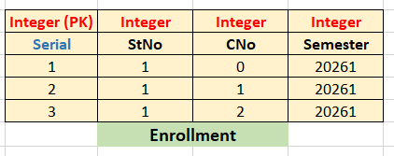
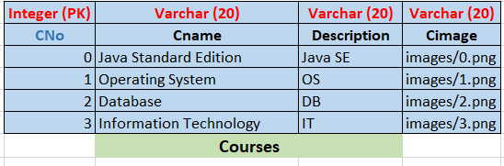
Tables

Slide 3
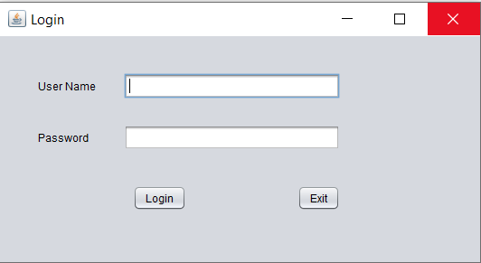
Login.java

Slide 4
Admin Screen

Slide 5
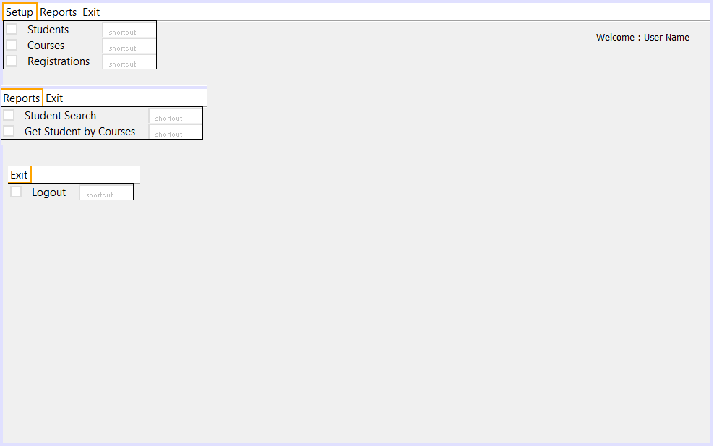
AdminMenu.java

Slide 6
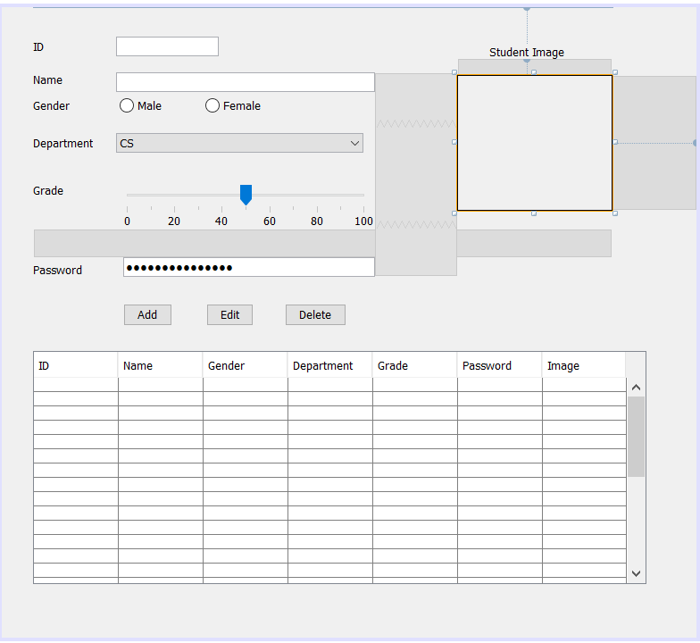
Setup\ AdminStudent.java

Slide 7
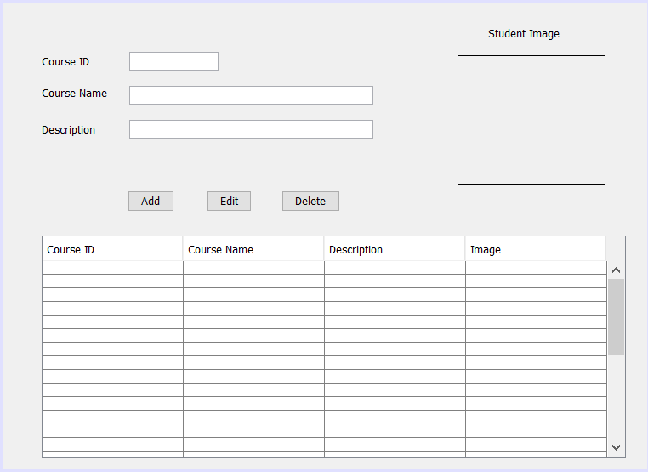
Setup\ AdminCourse.java

Slide 8
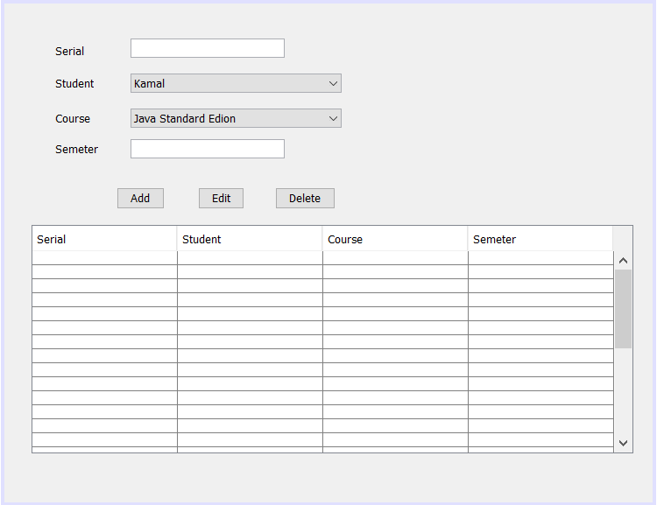
Setup\ AdminRegister.java

Slide 9
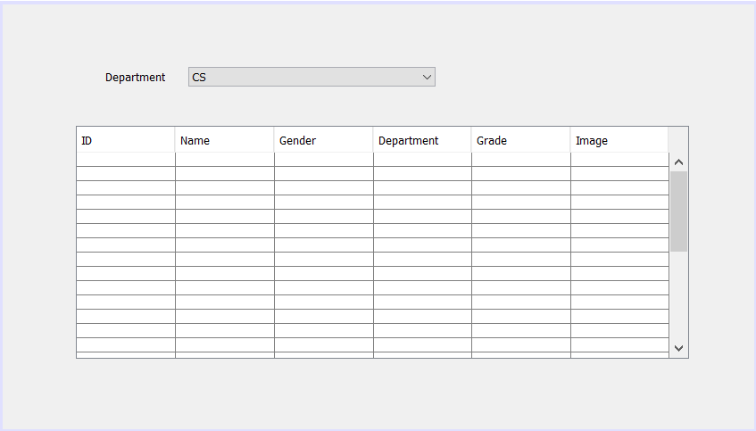
Reports/StudentSearch.java

Slide 10
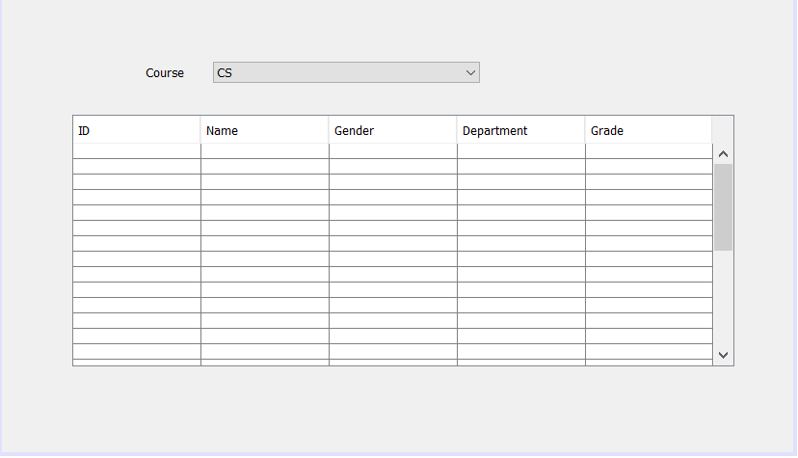
Reports \ SearchStudentEnroll.java

Slide 11
Admin Screen

Slide 12
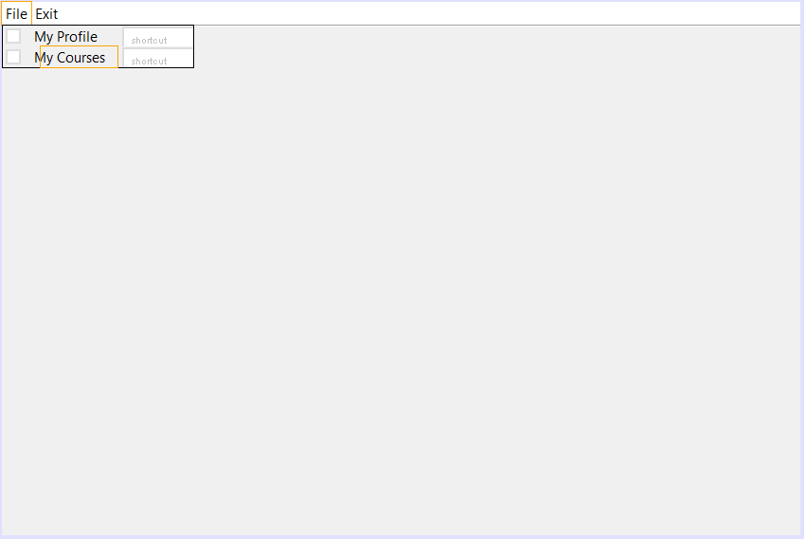
StudentMenu.java

Slide 13
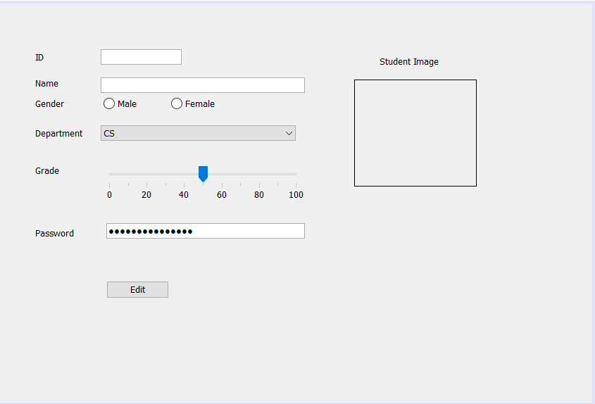
File / StudentProfile.java

Slide 14
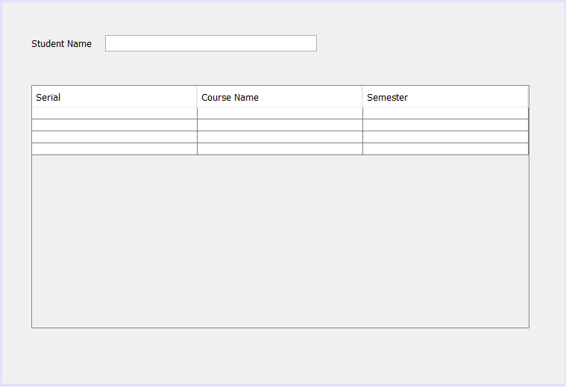
File / StudentCourseInfo.java

